Slide 1
Object Oriented Design
Elevator Management System
CS5004 Qiaowen Mei

Slide 2
01
Requirement
02
Define Class(core object)
03
Define field(properties)
04
Define method
05
Code & Test
Include functional and nonfunctional requirements
Defines the structure and behavior of objects of certain type
Hold information that characterizes the object's properties or characteristics
Is a function associated with an object or a class
Implement the functions and test

Slide 3
01
Requirement
x
y
Include functional and nonfunctional requirements

Slide 4
Requirement
Basic Function
User Interface
Safety
Clear indication and button for passengers use
Emergency button should be available
Elevator status: up, down, stop
Elevator should move between floors
Elevator should respond to floor requests
Passengers able to request elevator from any floors
Elevator Capacity
Elevator Type

Slide 5
02
Define Class
404 NOT FOUND
Defines the structure and behavior of objects of certain type

Slide 6
Define class
Elevator cab
Button panel
Elevator System
floors
doors
alarm
Inside, outside

Slide 7
03
Define field
Hold information that characterizes the object's properties or characteristics

Slide 8
Define field
Floor
ElevatorCab
-floorNumber
-state(stop, up, down)
-current floor

Slide 9
04
Define method
Is a function associated with an object or a class

Slide 10
Define method
ElevatorCab
ElevatorButton
Take external request/take internal request
Open gate/close gate
Check weight
Press button

Slide 11
Define method(data flow)
elevator system dispatch the request to target elevator using algorithm
take external request
elevator move toward customer
open gate, close gate
move to target floor
open gate, close gate

Slide 12
05
Algorithm, code, test
How data flow works

Slide 13
Algorithm
Shortest seek time first: This algorithm prioritizes serving the nearest request from the current position of the elevator. It minimizes the average waiting time for passengers.

Slide 14
Algorithm
Scan (Elevator): Also known as the Elevator algorithm, it moves the elevator in one direction, serving all requests in that direction until none are remaining, then changes direction. It's like a scanning motion.

Slide 15
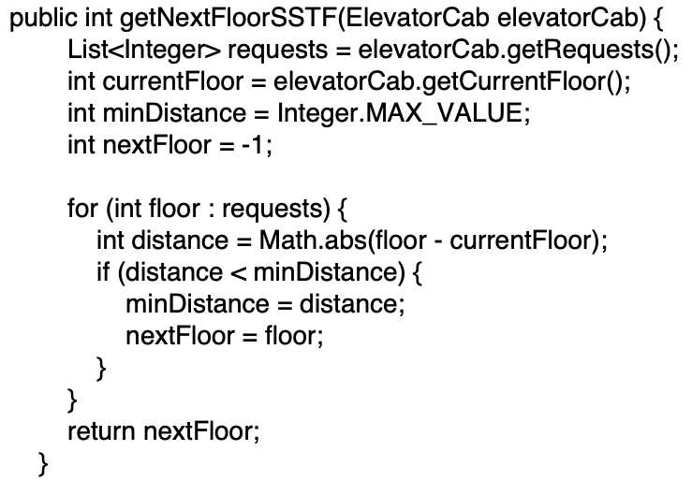
Code

Slide 16
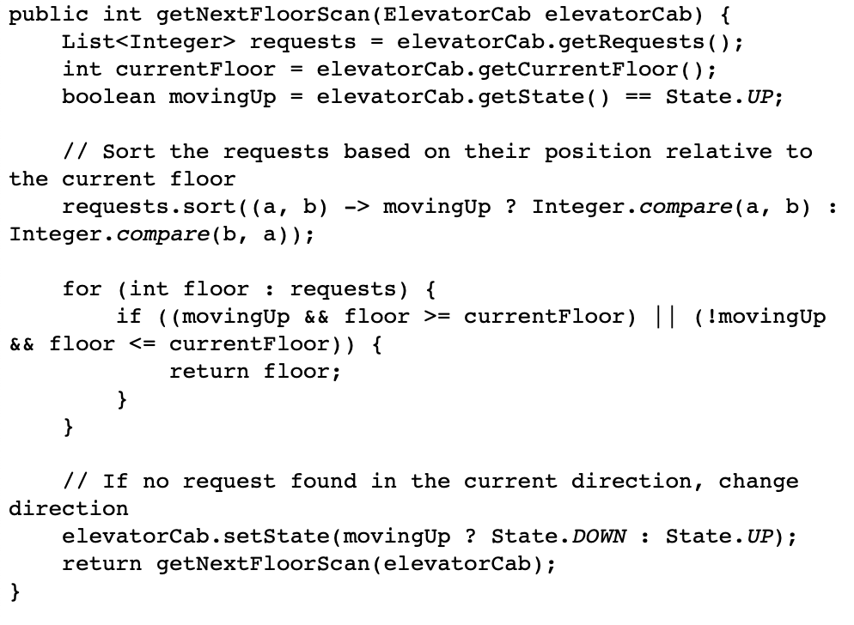
Code

Slide 17
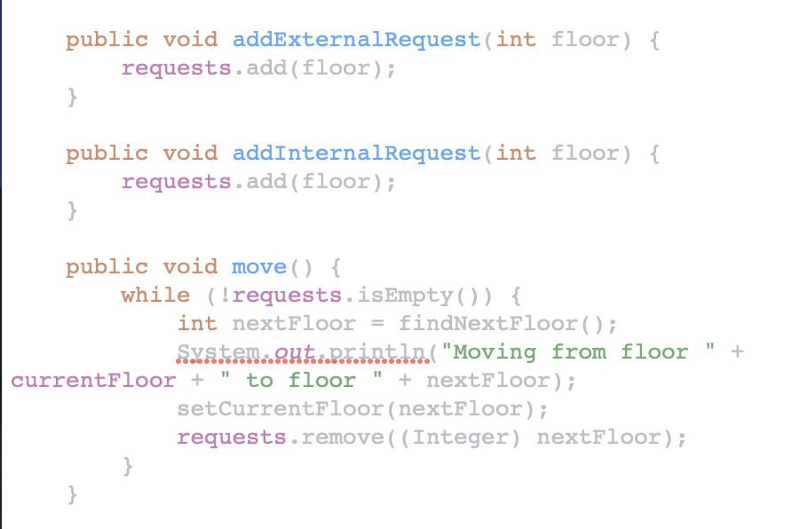
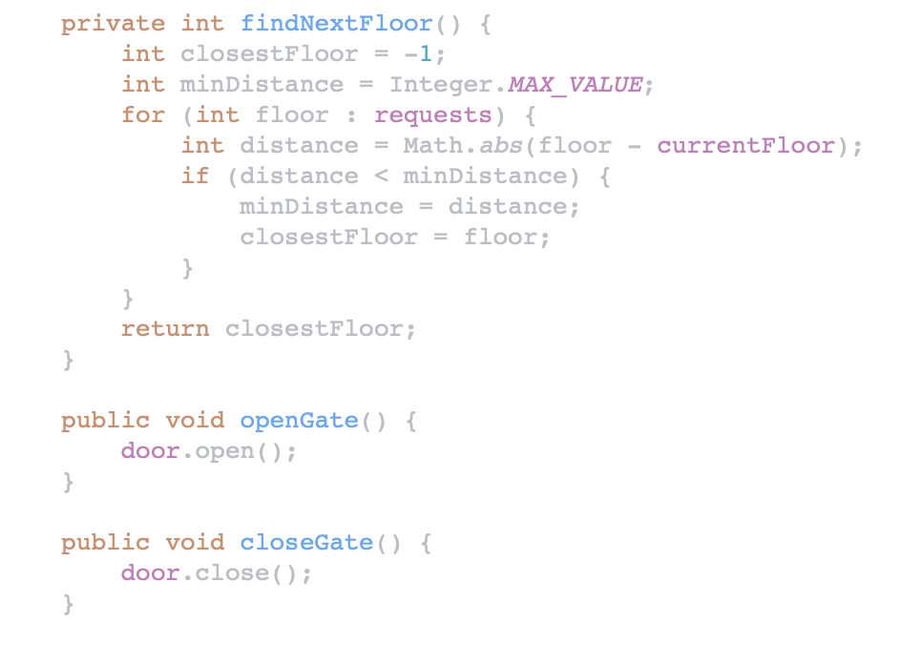
Elevator Cab

Slide 18
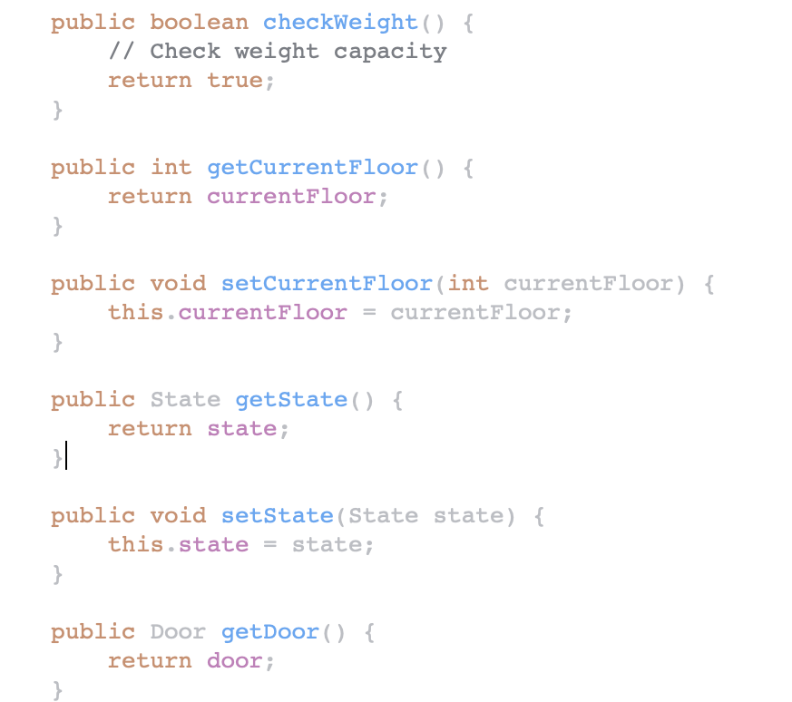
Elevator Cab

Slide 19
Code
Alarm
Door
Floor
ButtonPanel
activate(); deactivate(); isActivate()
open(); close(); isOpen()
getFloorNumber()
pressButton()

Slide 20
Reference
[1] “Build software better, together,” GitHub, https://github.com/topics/elevator-system (accessed Apr. 23, 2024).
[1] A. K. Srivastava, “Designing elevator algorithms in Java using object-oriented principles,” Medium, https://medium.com/@ankitviddya/designing-elevator-algorithms-in-java-using-object-oriented-principles-359588871867 (accessed Apr. 23, 2024).
[1] Ted Wang, “Ood - design an elevator,” Ted Wang, https://tedweishiwang.github.io/journal/object-oriented-design-elevator.html (accessed Apr. 23, 2024).

Slide 21
Thank You!

